Slide 1
Styrene is reactiveBreathing high levels of styrene may cause changes in color vision, tiredness, feeling drunk, slowed reaction time, concentration problems, or balance problems. Hearing loss has been observed in animals exposed to very high concentrations of styrene.
NIOSH recommends that employers use Hierarchy of Controls to prevent injuries. If you work in an industry that uses styrene, please read chemical labels and the accompanying Safety Data Sheets for hazard information. Visit NIOSH’s page on Managing Chemical Safety in the Workplace to learn more about controlling chemical workplace exposures.
The following resources provide information about occupational exposure to styrene. Useful search terms for styrene include “ethenyl benzene,” “phenylethylene,” “styrene monomer,” “styrol,” and “vinyl benzene.”

Slide 2
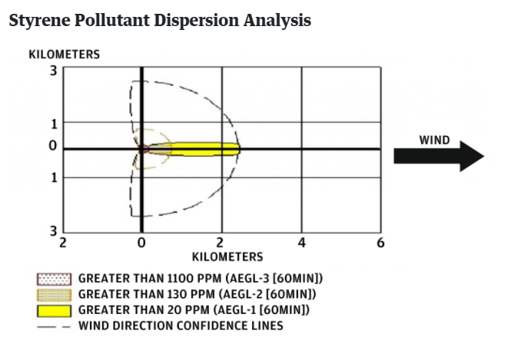

Slide 3
Styrene is readily absorbed and distributed throughout the body tissues following inhalation and dermal exposure
Acute inhalation of styrene may cause irritation of the nose and throat, increased nasal secretion, wheezing, coughing, pulmonary oedema, cardiac arrhythmias and coma Chronic occupational exposure to styrene may cause signs and symptoms of CNS depression, including decreased coordination and concentration, impairment of short term memory, altered liver function and abnormal ECG patterns Styrene is quickly broken down in the air, usually within 1–2 days. Styrene evaporates from shallow soils and surface water. Styrene that remains in soil or water may be broken down by bacteria or other microorganisms.

Slide 4
V we are exposing to the styrene by different ways by air buy water and soil by workplace air by food
The most common health problems in workers exposed to styrene involve the nervous system. These health effects include changes in color vision, tiredness, feeling drunk, slowed reaction time, concentration problems, and balance problems. The styrene concentrations that cause these effects are more than 1,000 times higher than the levels normally found in the environment.
Hearing loss has been observed in animals exposed to very high concentrations of styrene. Animal studies have shown that inhalation of styrene can result in changes in the lining of the nose and damage to the liver; however, animals may be more sensitive than humans to the nose and liver effects.

Slide 5
The International Agency for Research on Cancer has determined that styrene is a possible carcinogen.
Tobacco smoke Styrene is a component of tobacco smoke. Avoid smoking in enclosed spaces like inside the home or car in order to limit exposure to children and other family members.
Copier Styrene is released during the use of home copiers. Families should use a copier only when needed and turn it off when finished. It is also important to keep the room with the copier well ventilated.

Slide 6
utions and Safety Measures
First step to bring the situation in control is to not panic and shout. This can make your lungs suffocated
Do not run here and there and tire yourself. This makes the situation worse and affects your body harmfully
Do not leave the house without wearing a mask. Step out only if very necessary
Use wet masks to avoid inhaling the poisonous gas. If you do not have the mask, cover your mouth and nose with a wet cloth
If you have come in contact with the gas, try to reach to a safe spot and take deep breath

Slide 7
The fumes spread over a radius of 3km (1.86 mi).^{[19][13][20]} Five villages (R. R. Venkatapuram, Padmapuram, BC Colony, Gopalapatnam, and Kamparapalem) were the most affected areas.^{[21]} Hundreds of people were rushed to hospitals following widespread breathing difficulties and sensations of burning eyes.^{[12]} Many had been found lying on the ground, unconscious as a result of gas exposure. The initial estimate noted at least 11 deaths and 20–25 people in critical condition.^{[22]} By the next day, the death toll had risen to thirteen.^{[23]} More than 1,000 people were reportedly exposed to the gas

Slide 8
On the day of the leak, the levels of styrene in the air in the area were 500 times higher than prescribed limit. Media reports said they were more than 2,500 parts per billion (ppb), while World Health Organization norms require them to be under 5 ppb. The Visakhapatnam facility is spread over 240 hectares (ha), including the nearby residential areas. There is also a revenue village nearby, which resulted in a higher rate of exposure.
. It should be less than 5 parts per billion (ppb) according to rules.

Slide 9
It can enter the body through respiration, but also through the skin and eyes. According to India’s Manufacture, Storage and Import of Hazardous Chemical Rules 1989, styrene is classified as a “hazardous and toxic chemical”. Short-term exposure to styrene in humans results in irritation in the mucous membrane and eye, and gastrointestinal problems. Long-term exposure impacts the central nervous system, leading to headaches, fatigue, weakness, depression, dysfunction, hearing loss, and peripheral neuropathy. If the concentration of styrene goes beyond 800 ppm, then the person exposed to it can go into a coma. Experts say that immediately after the leak, the levels could have crossed 1,000 ppm in the nearby areas, which is why people started fainting.

